Slide 1
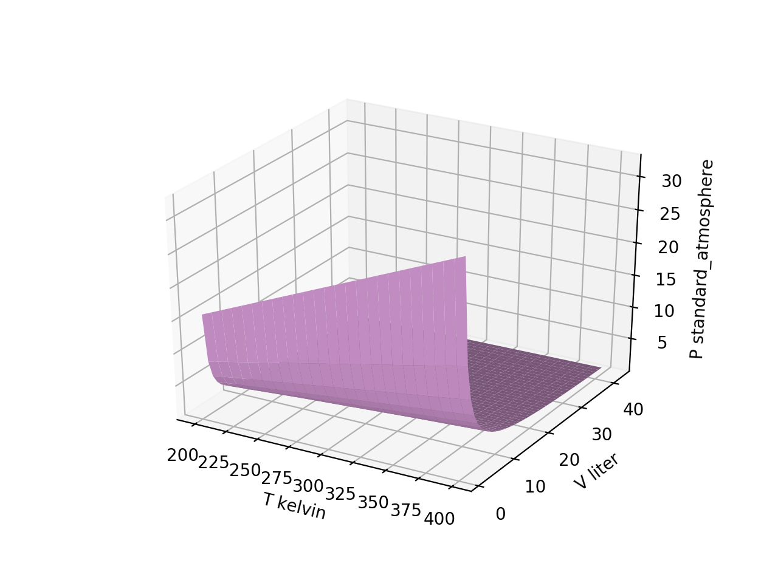
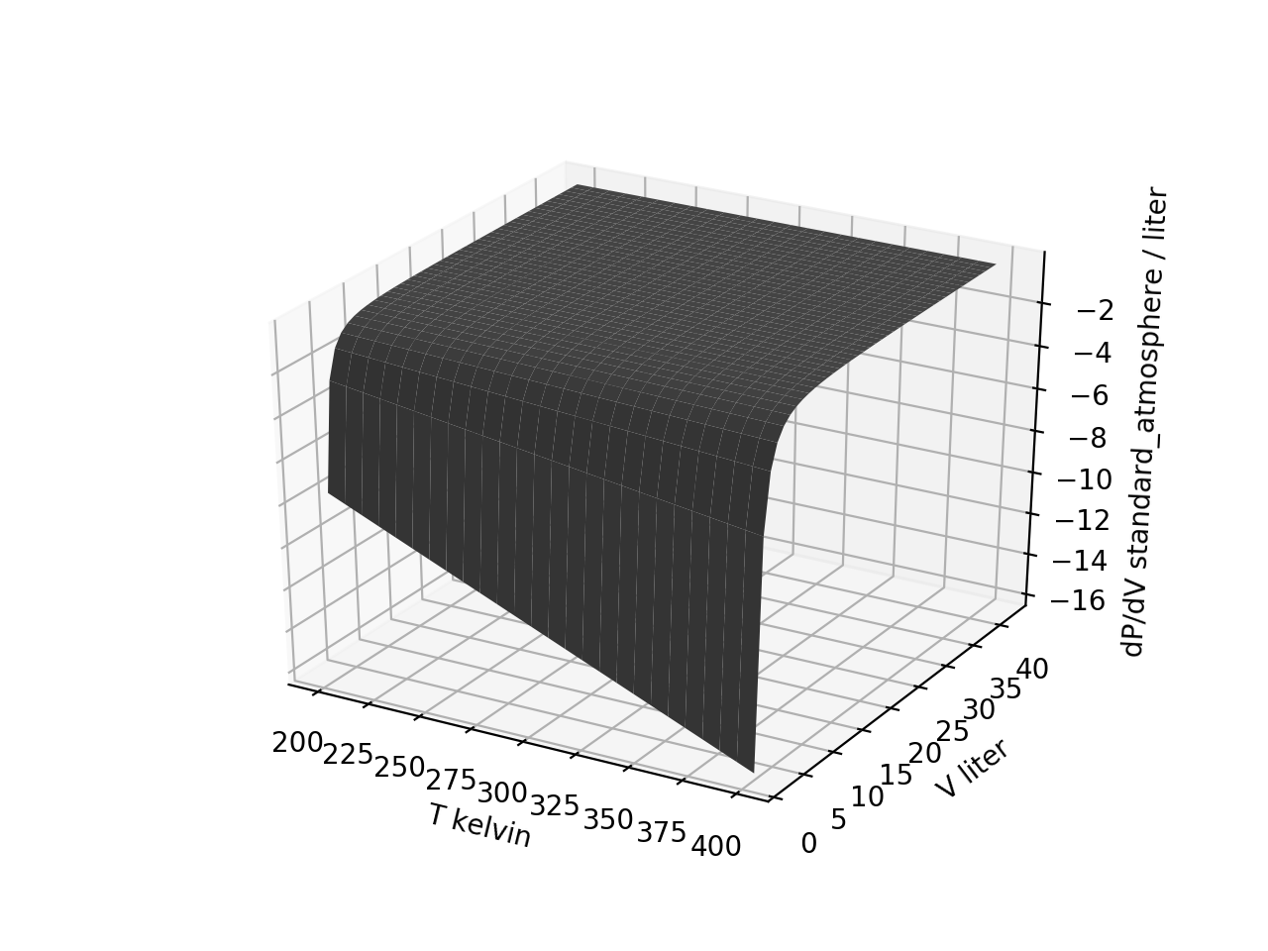


Week 2 – Slopes of thermodynamic surfaces are also thermodynamic surfaces
$${\left(\frac{∂P}{∂V}\right)}_{T}$$
$$P\left(T,V\right)$$

Slide 2
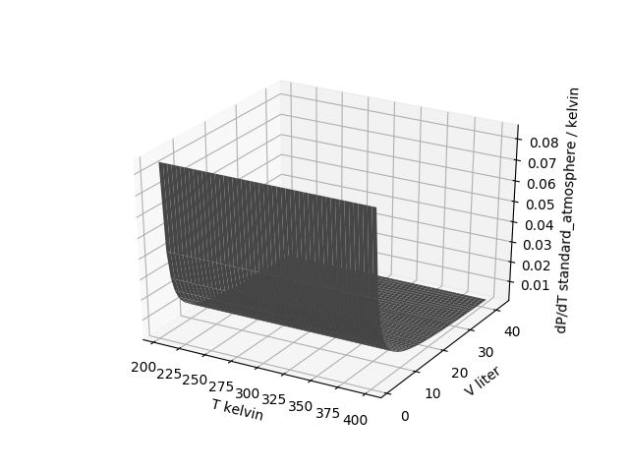

Week 2 – Slopes of thermodynamic surfaces are also thermodynamic surfaces
$${\left(\frac{∂P}{∂T}\right)}_{V}$$
42 volumes
42 volumes
51 temperatures
50 temperatures

Slide 3
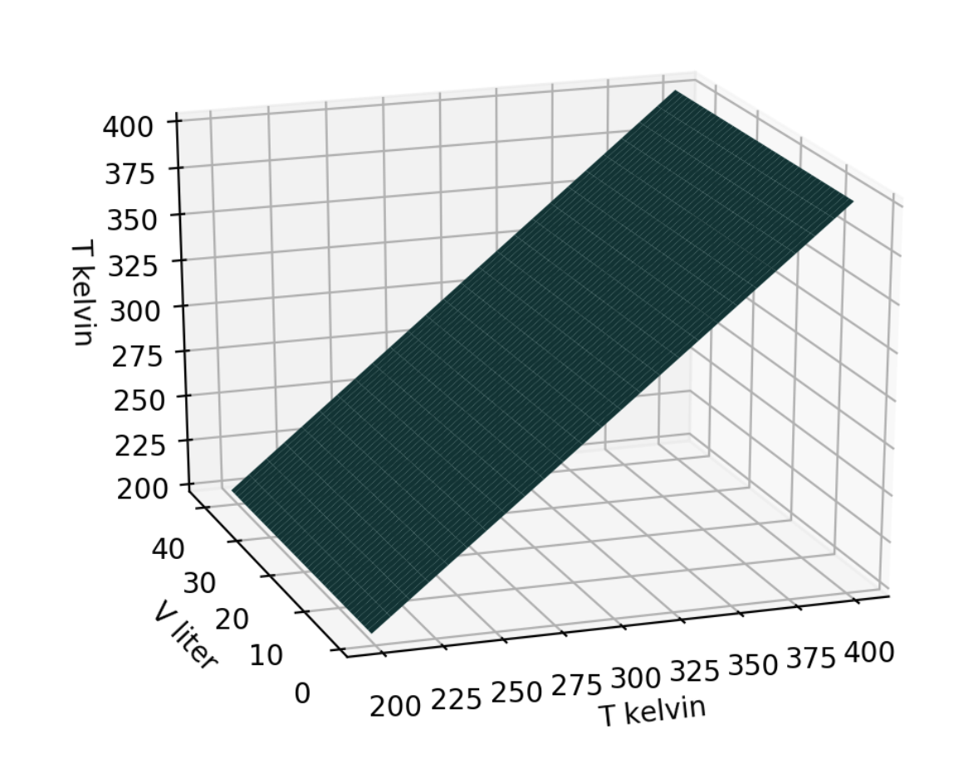
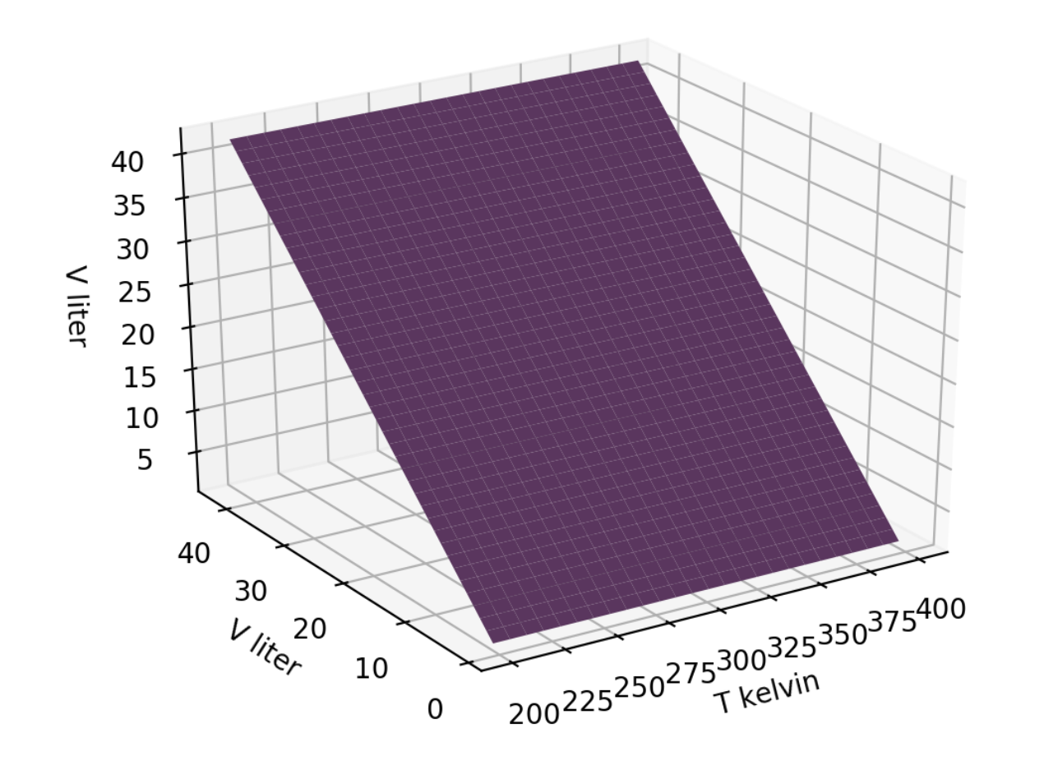


Week 2 – We can think of state space variables as thermodynamic surfaces too
$$T\left(T,V\right)$$
$$V\left(T,V\right)$$
42 volumes
42 volumes
51 temperatures
51 temperatures

Slide 4
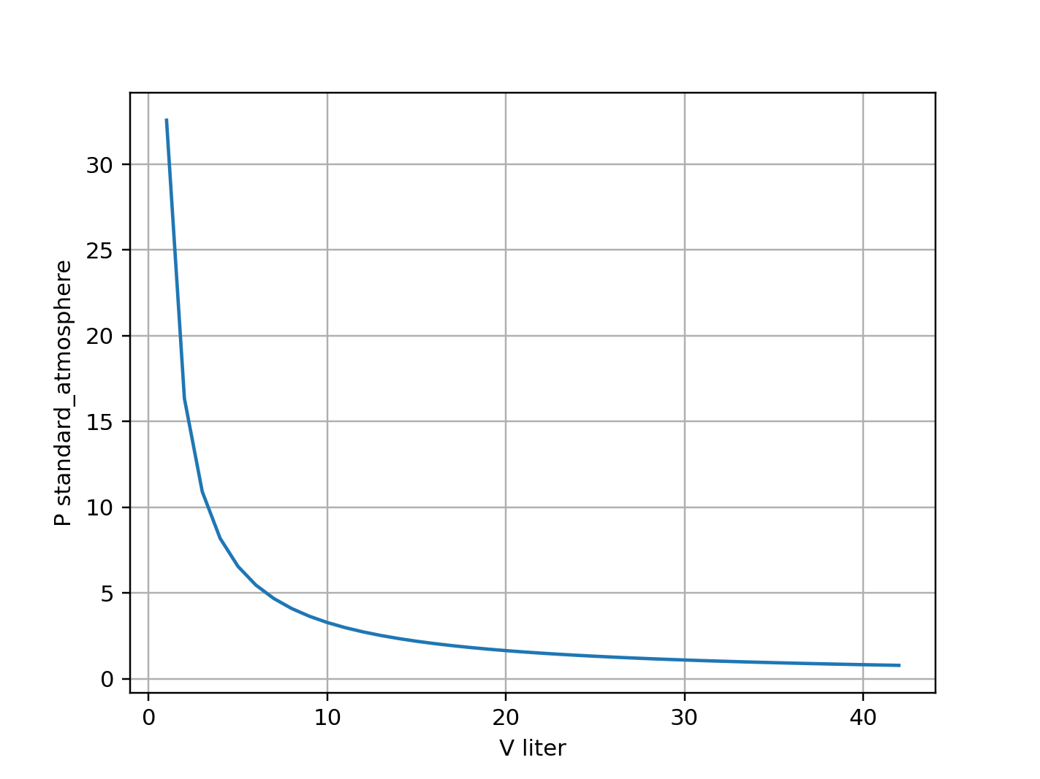

The kind of question I might ask – Slicing
Assuming grids have been organized in the way we’ve been doing it, which might give you the curve shown on the right?
$$P(T,V)$$
Pgrid[:,-1]
Pgrid[-1,:]
Pgrid[-1,-1]
Pgrid[:,:]
Notes:
Week 2

Slide 5
The kind of question I might ask – Slicing
Assuming grids have been organized in the way we’ve been doing it, which might give you the curve shown on the right?
$$P(T,V)$$
Pgrid[:,-1]
Pgrid[-1,:]
Pgrid[-1,-1]
Pgrid[:,:]
Notes:
Week 2

Slide 6
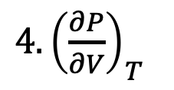
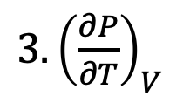
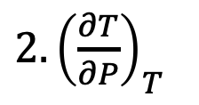
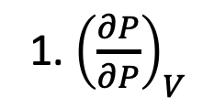
The kind of question I might ask – Partial derivatives (slopes) of thermodynamic surfaces
Assuming ideal gas behavior, which surface could the one on the right be?
1. ${\left(\frac{∂P}{∂P}\right)}_{V}$
$2. {\left(\frac{∂T}{∂P}\right)}_{T}$
${3. \left(\frac{∂P}{∂T}\right)}_{V}$
${4. \left(\frac{∂P}{∂V}\right)}_{T}$
Notes:
Week 2

Slide 7
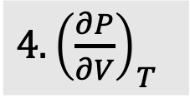
The kind of question I might ask – Partial derivatives (slopes) of thermodynamic surfaces
Assuming ideal gas behavior, which surface could the one on the right be?
1. ${\left(\frac{∂P}{∂P}\right)}_{V}$
$2. {\left(\frac{∂T}{∂P}\right)}_{T}$
${3. \left(\frac{∂P}{∂T}\right)}_{V}$
${4. \left(\frac{∂P}{∂V}\right)}_{T}$
Notes:
Week 2

Slide 8
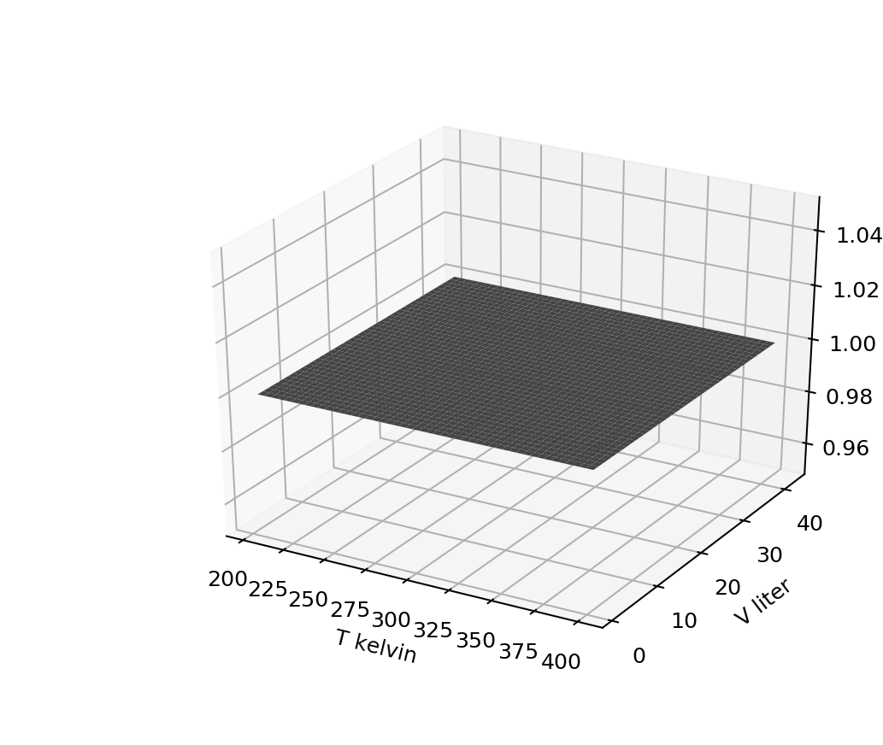
The kind of question I might ask – Partial derivatives (slopes) of thermodynamic surfaces
Assuming ideal gas behavior, which thermodynamic surface could this be?
1. ${\left(\frac{∂P}{∂P}\right)}_{V}$
$2. {\left(\frac{∂T}{∂P}\right)}_{T}$
${3. \left(\frac{∂P}{∂T}\right)}_{V}$
${4. \left(\frac{∂P}{∂V}\right)}_{T}$
Notes:
Week 2

Slide 9
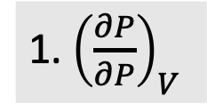
The kind of question I might ask – Partial derivatives (slopes) of thermodynamic surfaces
Assuming ideal gas behavior, which thermodynamic surface could this be?
1. ${\left(\frac{∂P}{∂P}\right)}_{V}$
$2. {\left(\frac{∂T}{∂P}\right)}_{T}$
${3. \left(\frac{∂P}{∂T}\right)}_{V}$
${4. \left(\frac{∂P}{∂V}\right)}_{T}$
Notes:
Week 2

Slide 10
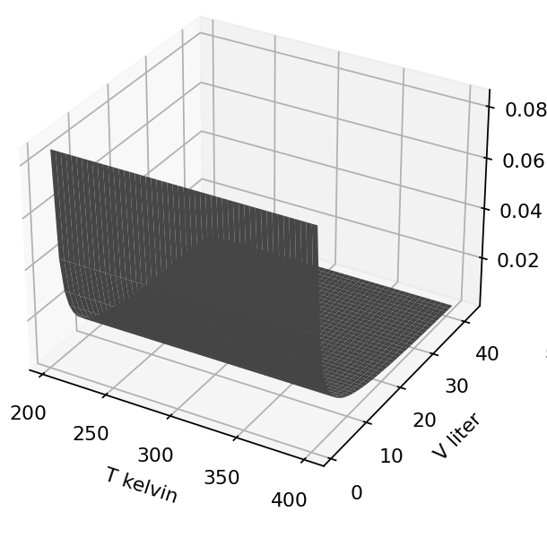
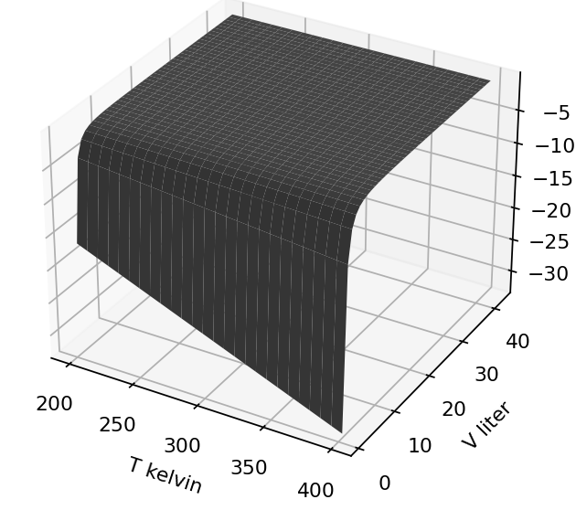

The kind of question I might ask – Calculus of partial derivatives
Suppose $P=\frac{nRT}{V−nb} −\frac{n^{2}a}{V×(V−nb)}$. Find the algebraic expression corresponding to one of these (your choice):
${\left(\frac{∂P}{∂T}\right)}_{V}=$
${\left(\frac{∂P}{∂V}\right)}_{T}=$
Notes:
Week 2

